Slide 1
Movie popularity prediction using the Content Based Recommender System
Presented by- M.V.BhagyaSree(197R1A05F2)
E.Saikiran(197R1A05D6)
S.Vamshi(197R1A05H0)
Guide- Najeema Afrin

Slide 2
Abstract
The movie is one of the integral components of our everyday entertainment. The worldwide movie industry is one of the most growing and significant industries and seizing the attention of people of all ages. It has been observed in a recent study that only a few movies achieve success.
Uncertainty in the sector has created immense pressure on the film production stakeholder. Moviemakers and researchers continuously feel it necessary to have some expert systems predicting the movie success probability preceding its production with reasonable accuracy. A maximum of the research work has been conducted to predict the movie’s popularity in the post-production stage.
To help the movie maker estimate the upcoming film and make necessary changes, we need to conduct the prediction at the early stage of movie production and provide specific observations about the upcoming movie.

Slide 3
EXISTING SYSTEM
In existing system the crew only estimate the degree of success of upcoming. A forecast was made soon after the cast , director, and storyline had been finalized would assist the investor in making financial decision.
Earlier, several works have been conducted on post-production or post-release forecast. However, it is not beneficial as the investor has already contributed their funds to the film.
The early production stage and pre-production prediction with satisfying accuracy have been beneficial to secure investment

Slide 4
Disadvantages
Given that it stores all of the training, it can be computationally expensive.
The output/results are not more accurate.
It is not beneficial as the investor has already contributed their funds to the film.

Slide 5
PROPOSED SYSTEM
This study has proposed a content-based (CB) movie recommendation system (RS) using preliminary movie features like genre, cast, director, keywords, and movie description.
Using RS output and movie rating and voting information of similar movies, we created a new feature set and proposed an ML model to build a multiclass movie popularity prediction system.
We also proposed a system to predict the popularity of the upcoming movie among different audience groups. We have divided the audience group into four age groups junior, teenage, mid-age, and senior. This study has used publicly available Internet Movie Database (IMDb) data and Movie Database (TMDb) data.
We implemented a multiclass classification model and achieved 92.6% accuracy, which outperforms all the benchmark models. This study highlights the potential of predictive and prescriptive data analytics in information systems to support industry decisions.

Slide 6
Advantages
We preferred CNN & other methods because it is straightforward to interpret.
It also produce the output in multi class form which predicts in age wise movie popularity.
Compared to the literature reviews whose accuracy falls in the interval of 60% and 75%, our models obviously perform better.

Slide 7
System Requirement
HARDWARE REQUIREMENTS:
Processor : Any Update Processer
Ram : Min 4 GB
Hard Disk : Min 100 GB
SOFTWARE REQUIREMENTS:
Operating System : Windows family
Technology : Python 3.6
Front-End : HTML, CSS, JS
IDE : PyCharm

Slide 8
Novelty:
Using the Movie content we predict the movie’s success or degree of success in a multiclass way.
This project helps us to predict or analyze the success rate of the upcoming movie with high accuracy.
Compare to the existing system it takes less time and produce the output with nearly 92.6% accuracy.

Slide 9
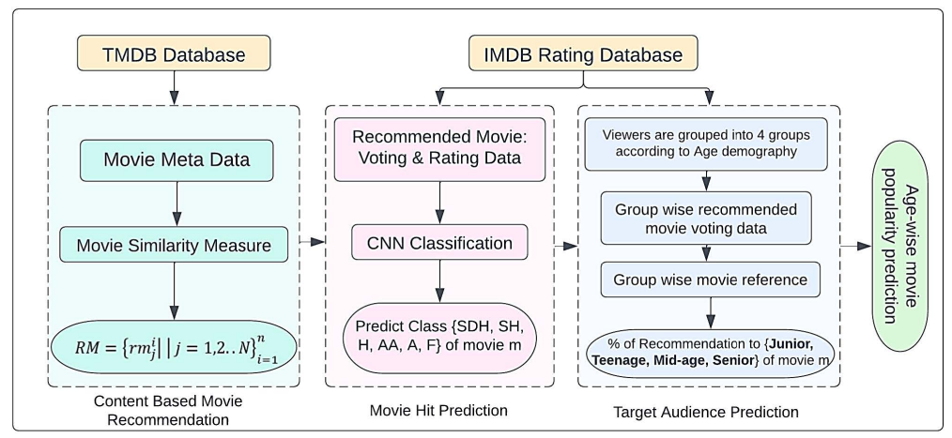
System Architecture:

Slide 10
Modules:
Dataset Collections(IMDB TMDB).
Data Preprocessing.
The TMDB dataset training with TF-IDF and KNN for CBMR
The IMDB dataset was trained with Random Forest for movie hit prediction.
The IMDB dataset was trained with Multi Layer Perceptron(MLP) for target audience prediction.

Slide 11
Class diagram:

Slide 12
Use case diagram:

Slide 13
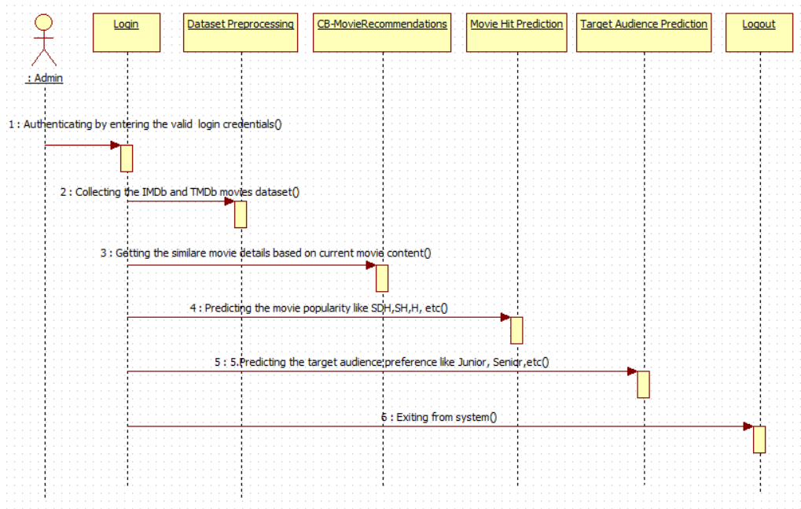
Sequence diagram:

Slide 14
Activity diagram:

Slide 15
Sample Code:
from flask import Flask, render_template, request flash
import pandas as pdfrom flask
import Responseimport csvfrom flask
import sessionfrom DBConnection
import DBConnectionimport sysfrom CBMR
import movie_recommendsfrom TargetAudience
import audience_predicitonfrom MoviePopularity
import movie_hit_prediction
app = Flask(_name_)app.secret_key = "abc“
cbmrs_list=[]
@app.route('/’)
def index():
return render_template('index.html’)
@app.route('/signin’)
def signin():
return render_template('user_signin.html’)
@app.route('/user_home’)
def user_home():
return render_template('user_home.html’)
@app.route('/signup’)
def signup():
return render_template('user_signup.html')

Slide 16
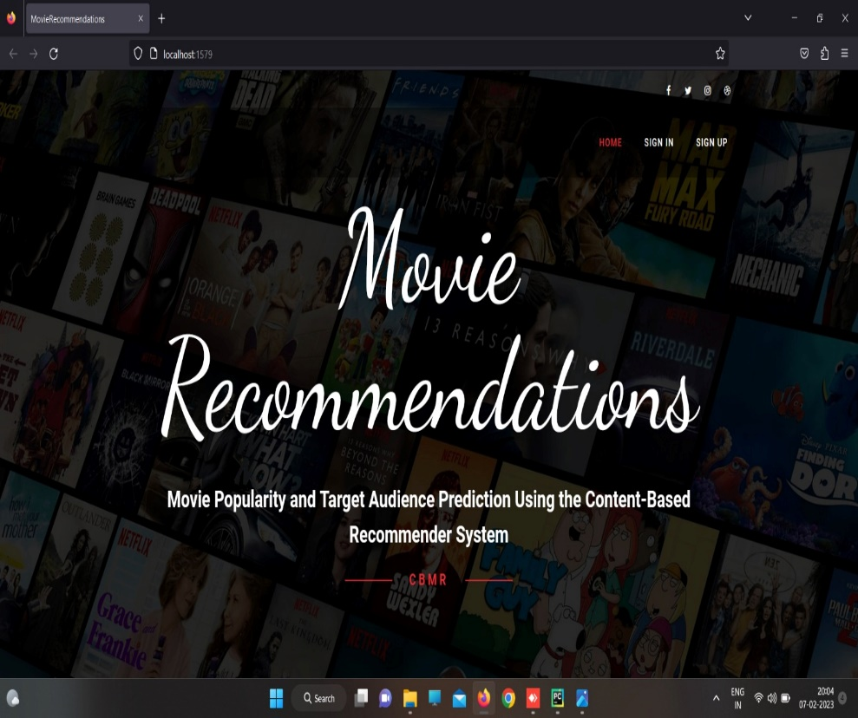
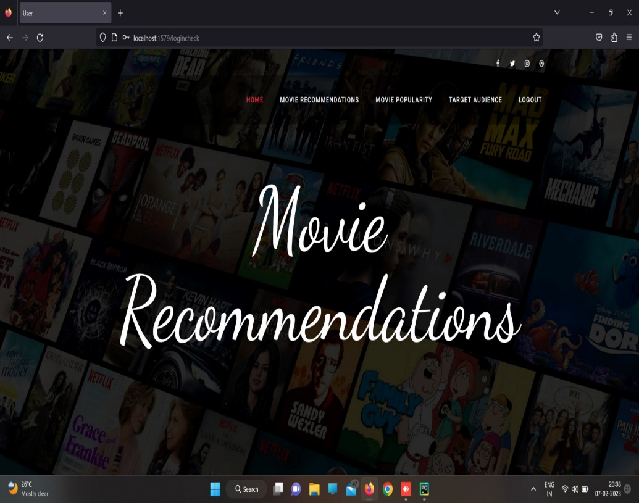
Output:

Slide 17
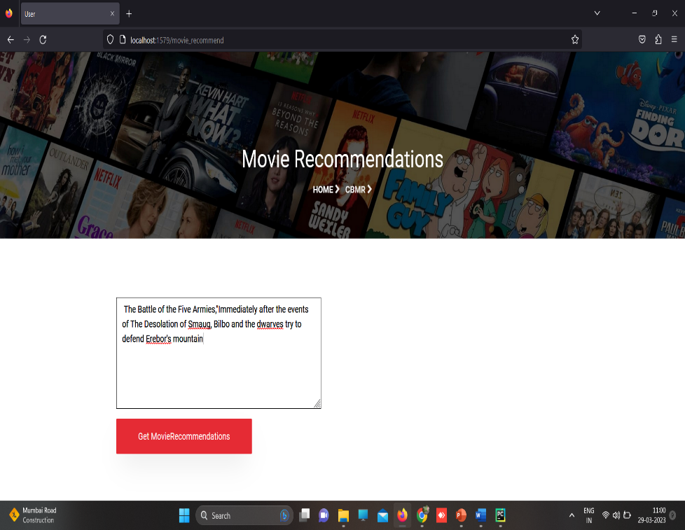
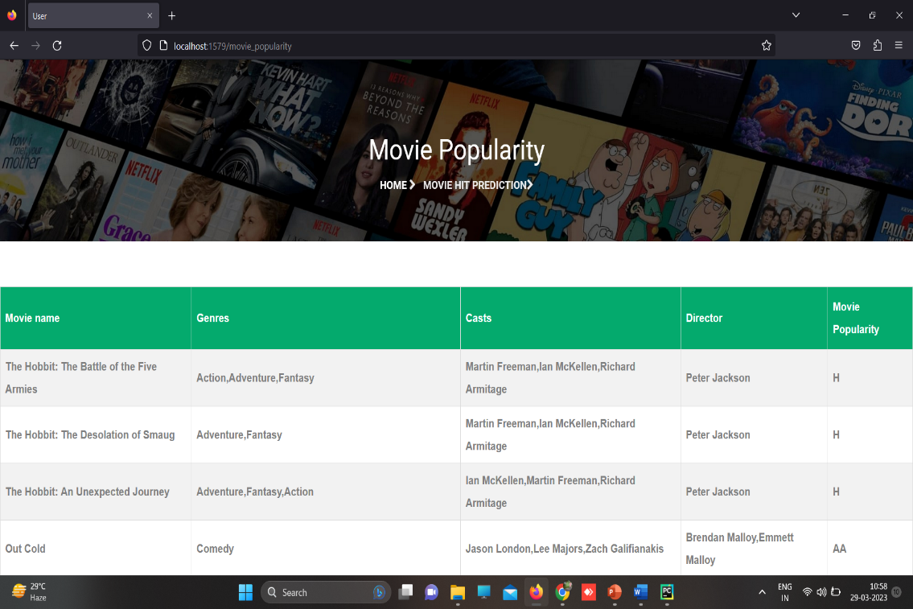

Slide 18
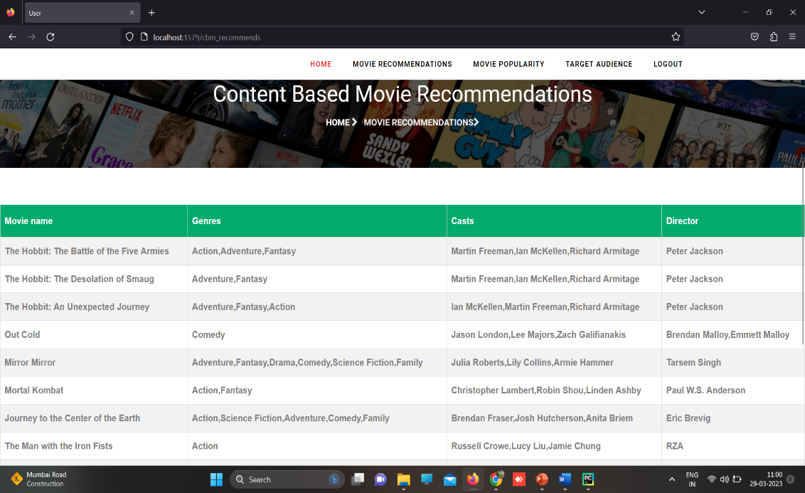
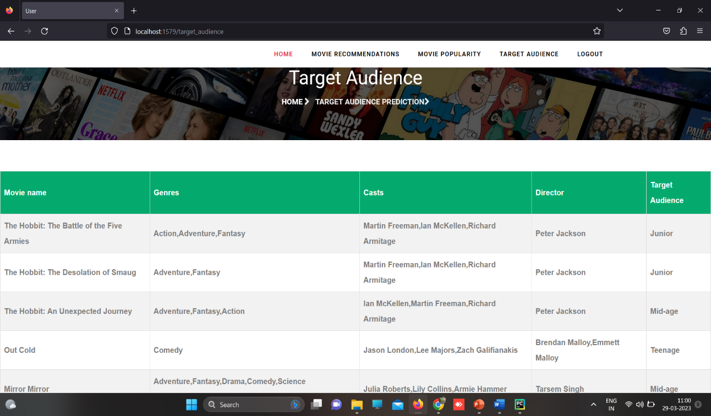

Slide 19
CONCLUSION
A substantial amount of financing is consumed in every box-office movie. However, most movies fail to achieve success. Earlier, the most significant number of works have been done on post-production or post-release forecast.
The estimate does not influence as the investor has already consumed their funds on the lM production.
The pre-production or early production stage forecast needs high accuracy and the best time to ensure investment . Through this ML recommending system one can predict the success rate of the upcoming movie.

Slide 20
References:
[1] L. Sharma and A. Gera, ``A survey of recommendation system: Research challenges,'' Int. J. Eng. Trends Technol., vol. 4, no. 5, pp. 1989_1992, 2013.
[2] N. Das, S. Borra, N. Dey, and S. Borah, ``Social networking in web based movie recommendation system,'' in Social Networks Science: Design, Implementation, Security, and Challenges. Cham, Switzerland: Springer, 2018, pp. 25_45.
[3] P. Nagarnaik and A. Thomas, ``Survey on recommendation system methods,'' in Proc. 2nd Int. Conf. Electron. Commun. Syst. (ICECS), Feb. 2015, pp. 1603_1608.
[4] M. A. Hameed, O. Al Jadaan, and S. Ramachandram, ``Collaborative _ltering based recommendation system: A survey,'' Int. J. Comput. Sci. Eng., vol. 4, no. 5, p. 859, 2012.
[5] B. Sarwar, G. Karypis, J. Konstan, and J. Reidl, ``Item-based collaborative _ltering recommendation algorithms,'' in Proc. 10th Int. Conf.WorldWide Web (WWW), 2001, pp. 285_295.
[6] Y. Koren and R. Bell, ``Advances in collaborative _ltering,'' in Rec-ommender Systems Handbook. Boston, MA, USA: Springer, 2015, pp. 77_118.
[7] J. L. Herlocker, J. A. Konstan, and J. Riedl, ``Explaining collaborative _ltering recommendations,'' in Proc. ACM Conf. Comput. supported Coop-erat. Work (CSCW), 2000, pp. 241_250.
[8] M. J. Pazzani, ``A framework for collaborative, content-based and demographic _ltering,'' Artif. Intell. Rev., vol. 13, no. 5, pp. 393_408, 1999.

Slide 21
Future enhancement
The proposed system is an excellent tool for the movie industry. In future work, multimedia data like audio and video data could be incorporated and also, and the poster of the upcoming movie could be used for better results. Recent train tickets could be analyzed using sentiment analysis of the social media data. Information regarding recent training on the market expectation from the movie industry will be beneficial for the movie makers. The audience group could be divided according to age and according to the demography or profession of the audience. That will be much easier for targeting and promoting an upcoming movie.

Slide 22
Thank you

